Slide 1
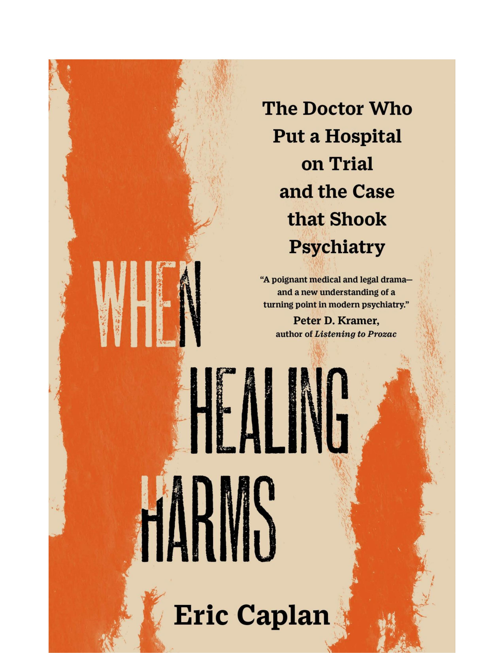
When Healing Harms
The Doctor Who Put a Hospital on Trial
and the Case That Shook Psychiatry
Eric Caplan, PhD
Historian of Psychiatry

Slide 2
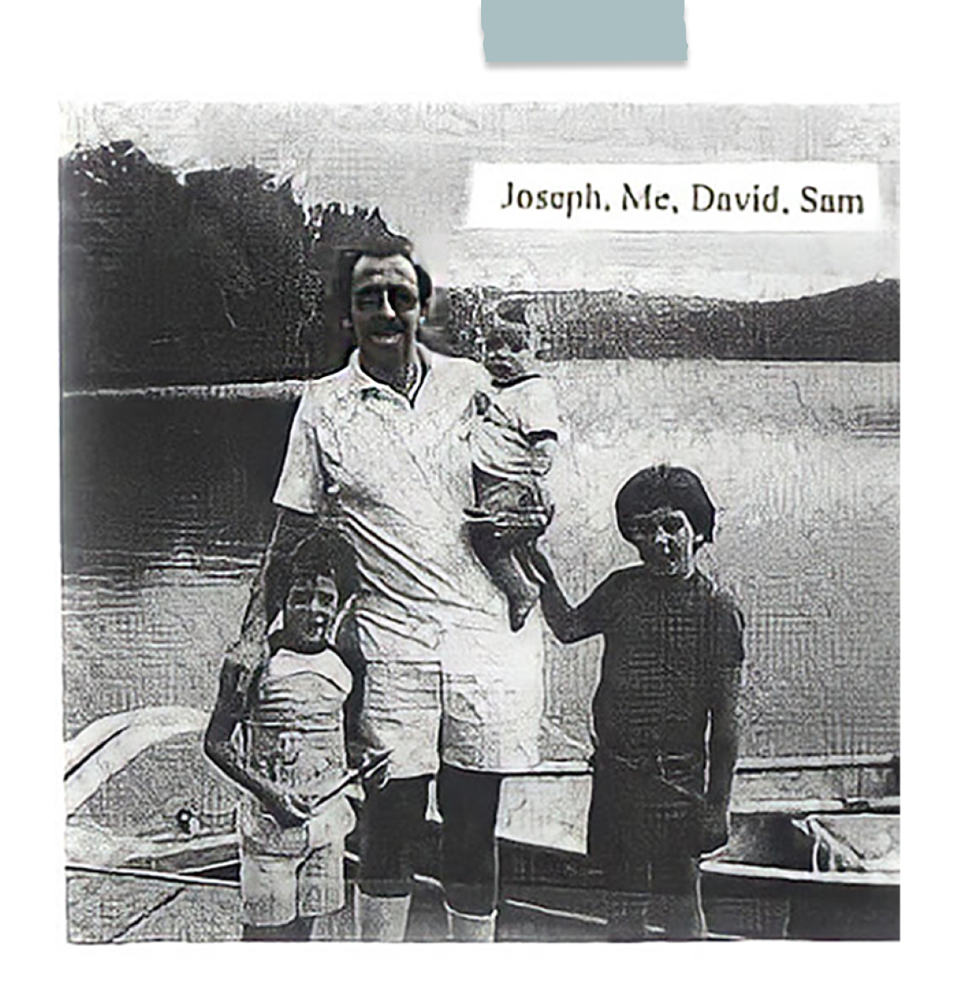
Who Was Ray Osheroff?
Physician and Musician
A practicing nephrologist — a doctor who treated kidney disease; master trumpet player and banjo player
Father & Husband
A man enmeshed in a painful divorce and custody battle
Patient
Suffering from severe depression that derailed his career and personal life
A Man in Crisis
Voluntarily admitted himself to Chestnut Lodge in January 1979, seeking help

Slide 3
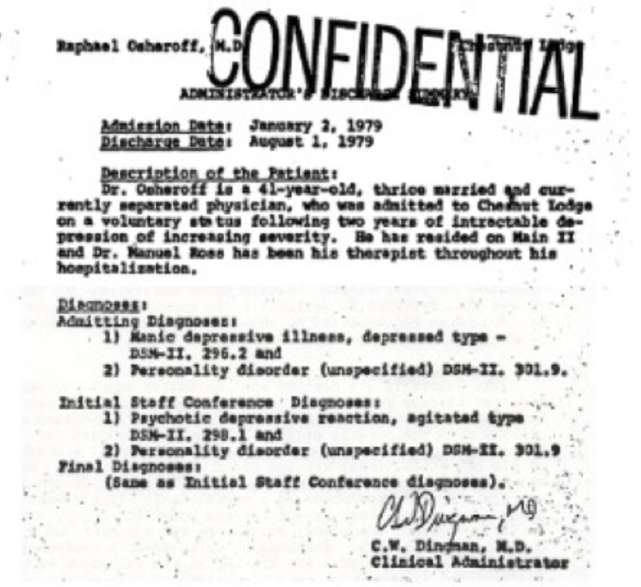
What Ailed Him
Severe Depression
Official Diagnosis
Debilitating depressive episodes that left him unable to function professionally or personally
Previous treatments had not resolved the underlying condition
A man in freefall — losing his practice, his marriage, and his sense of self

Slide 4
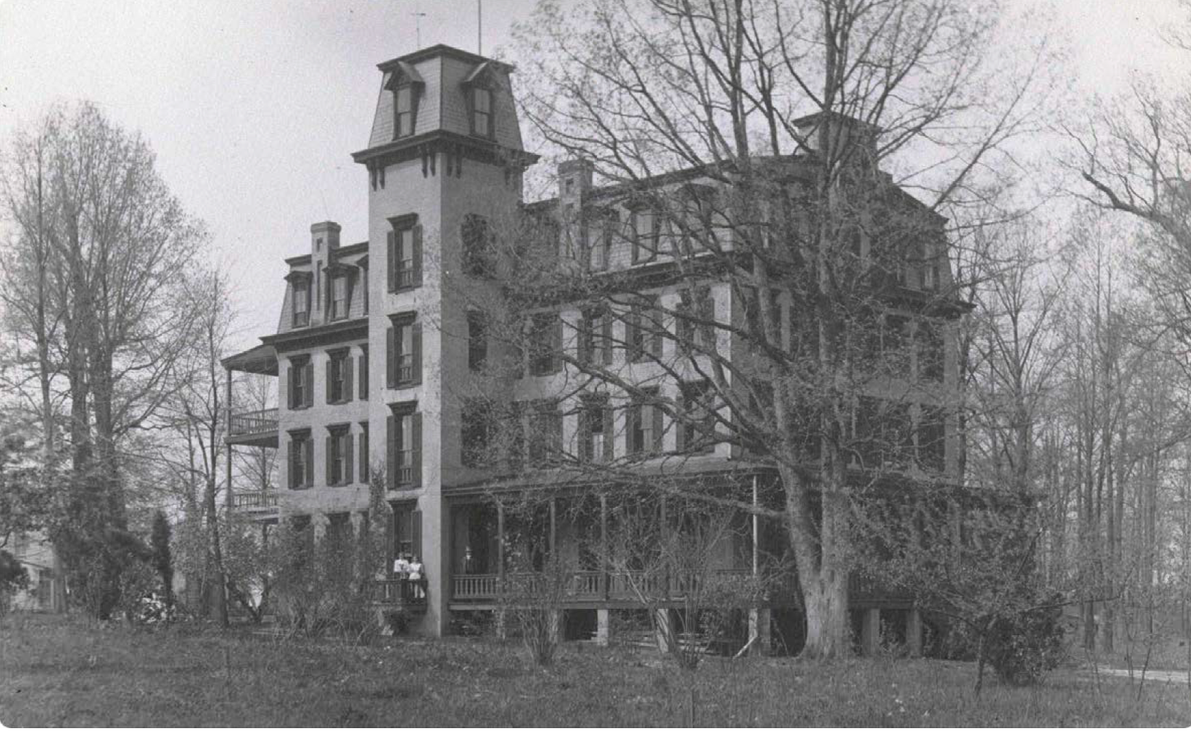
Chestnut Lodge
A Cathedral of Psychoanalysis
A legendary private psychiatric hospital in Rockville, Maryland
Devoted to intensive psychoanalytic psychotherapy — four or five sessions per week
Home to luminaries like Harry Stack-Sullivan, Frieda Fromm-Reichmann and Harold Searles
A bastion of the belief that even severe mental illness could be treated through the therapeutic relationship alone
By 1979, it was one of the last holdouts against the biological revolution sweeping psychiatry

Slide 5
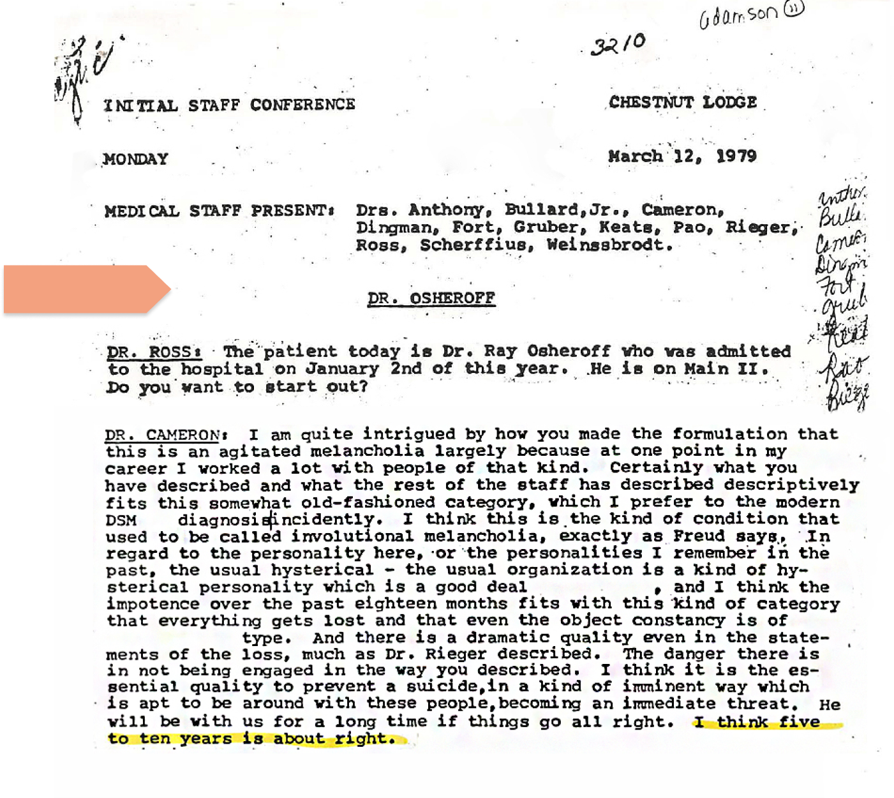
Proposed Treatment Plan: Five to 10 Years
No Medication. No Improvement.
Diagnosed with Manic depressive Illness, DSM-II. 301.9; revised to Psychotic depressive reaction, agitated type, DSM-II. 296.2
Treated exclusively with intensive individual psychotherapy
Staff interpreted his deterioration as therapeutic resistance, not treatment failure
Family's pleas for medication were rebuffed
A clinical case conference was held — the staff voted to continue the same course

Slide 6
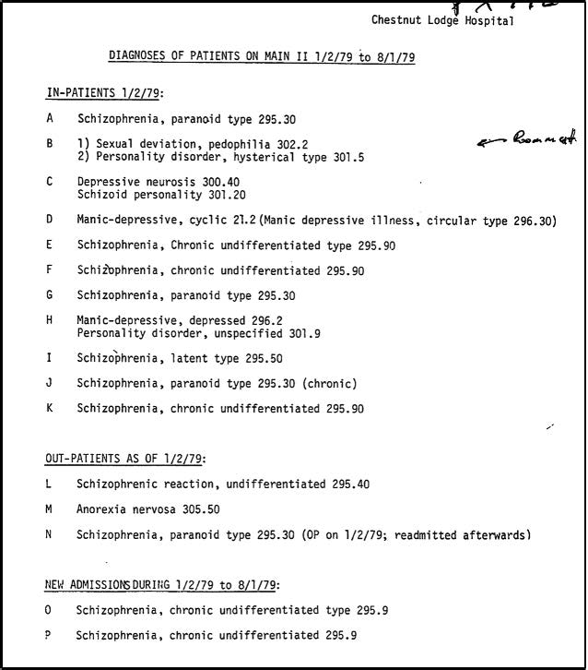
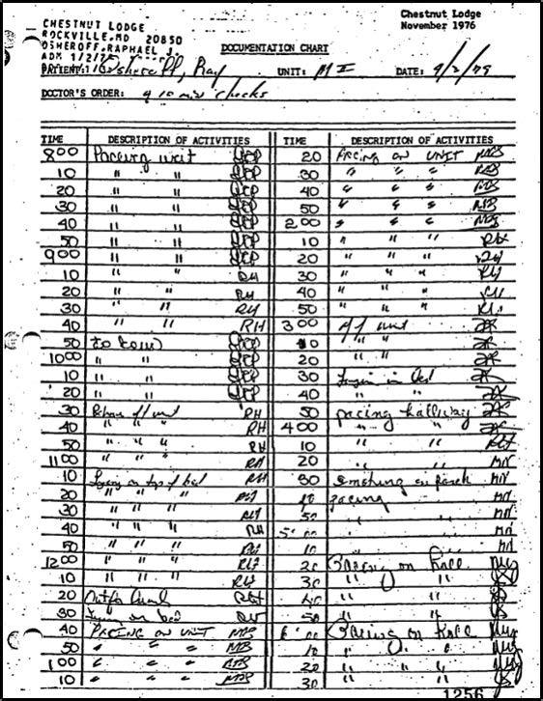
Life on Main II

Slide 7
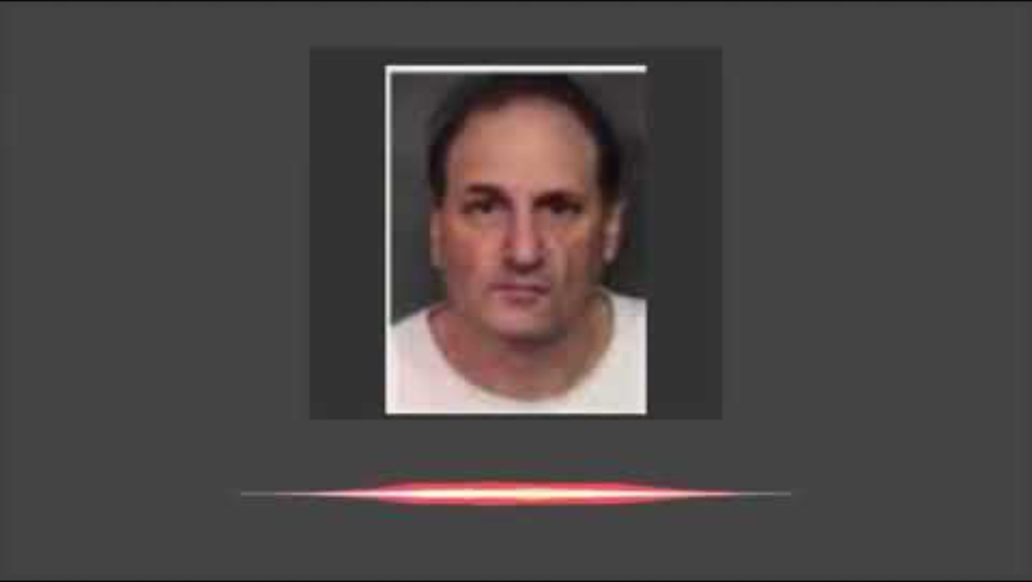
Ray Osheroff
That was pretty abusive.
Cold Wet Sheets Video

Slide 8
The Human Cost
40 lbs
Lost in weight during hospitalization
7 months
Of deterioration without medication
Blistered feet
From pacing the halls in agony and insomnia
His deterioration was visible to everyone — except those treating him.

Slide 9
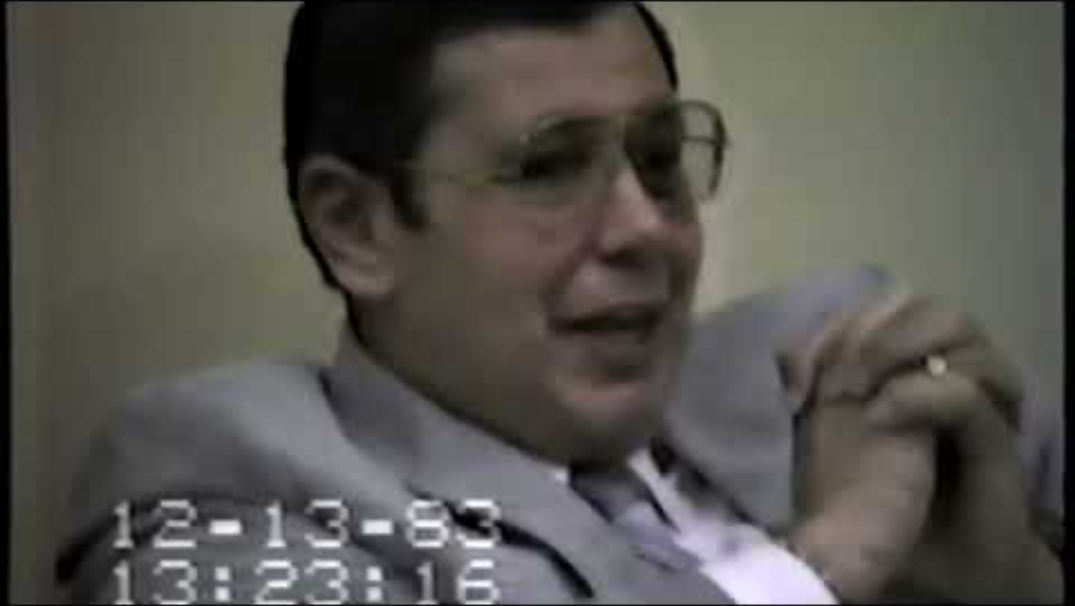
Ray Osheroff
How did he look?
Westerman Video

Slide 10
The Transfer
Late 1979
Ray's family, alarmed by his condition, consulted an outside psychiatrist
Discharge
Against the advice of Chestnut Lodge staff, the family had Ray transferred
Silver Hill
Admitted to Silver Hill Foundation in New Canaan, Connecticut
New Diagnosis
Diagnosed with psychotic depressive reaction — later reclassified as manic depression (bipolar disorder)

Slide 11
Recovery
CHESTNUT LODGE
SILVER HILL
7 months
No medication
Continuous deterioration
Weeks to respond
Phenothiazines + tricyclics
Dramatic improvement
Within three months, Ray walked out of Silver Hill — recovered.
But recovery was not the end of his story.

Slide 12
Homecoming
The life Ray returned to was not the one he had left.
His medical practice had collapsed during his hospitalization
His marriage was over; custody of his children was lost
Professional reputation severely damaged
Subsequent manic episodes complicated his recovery and his credibility
The man who emerged was not simply 'cured' — he was changed, diminished, angry

Slide 13
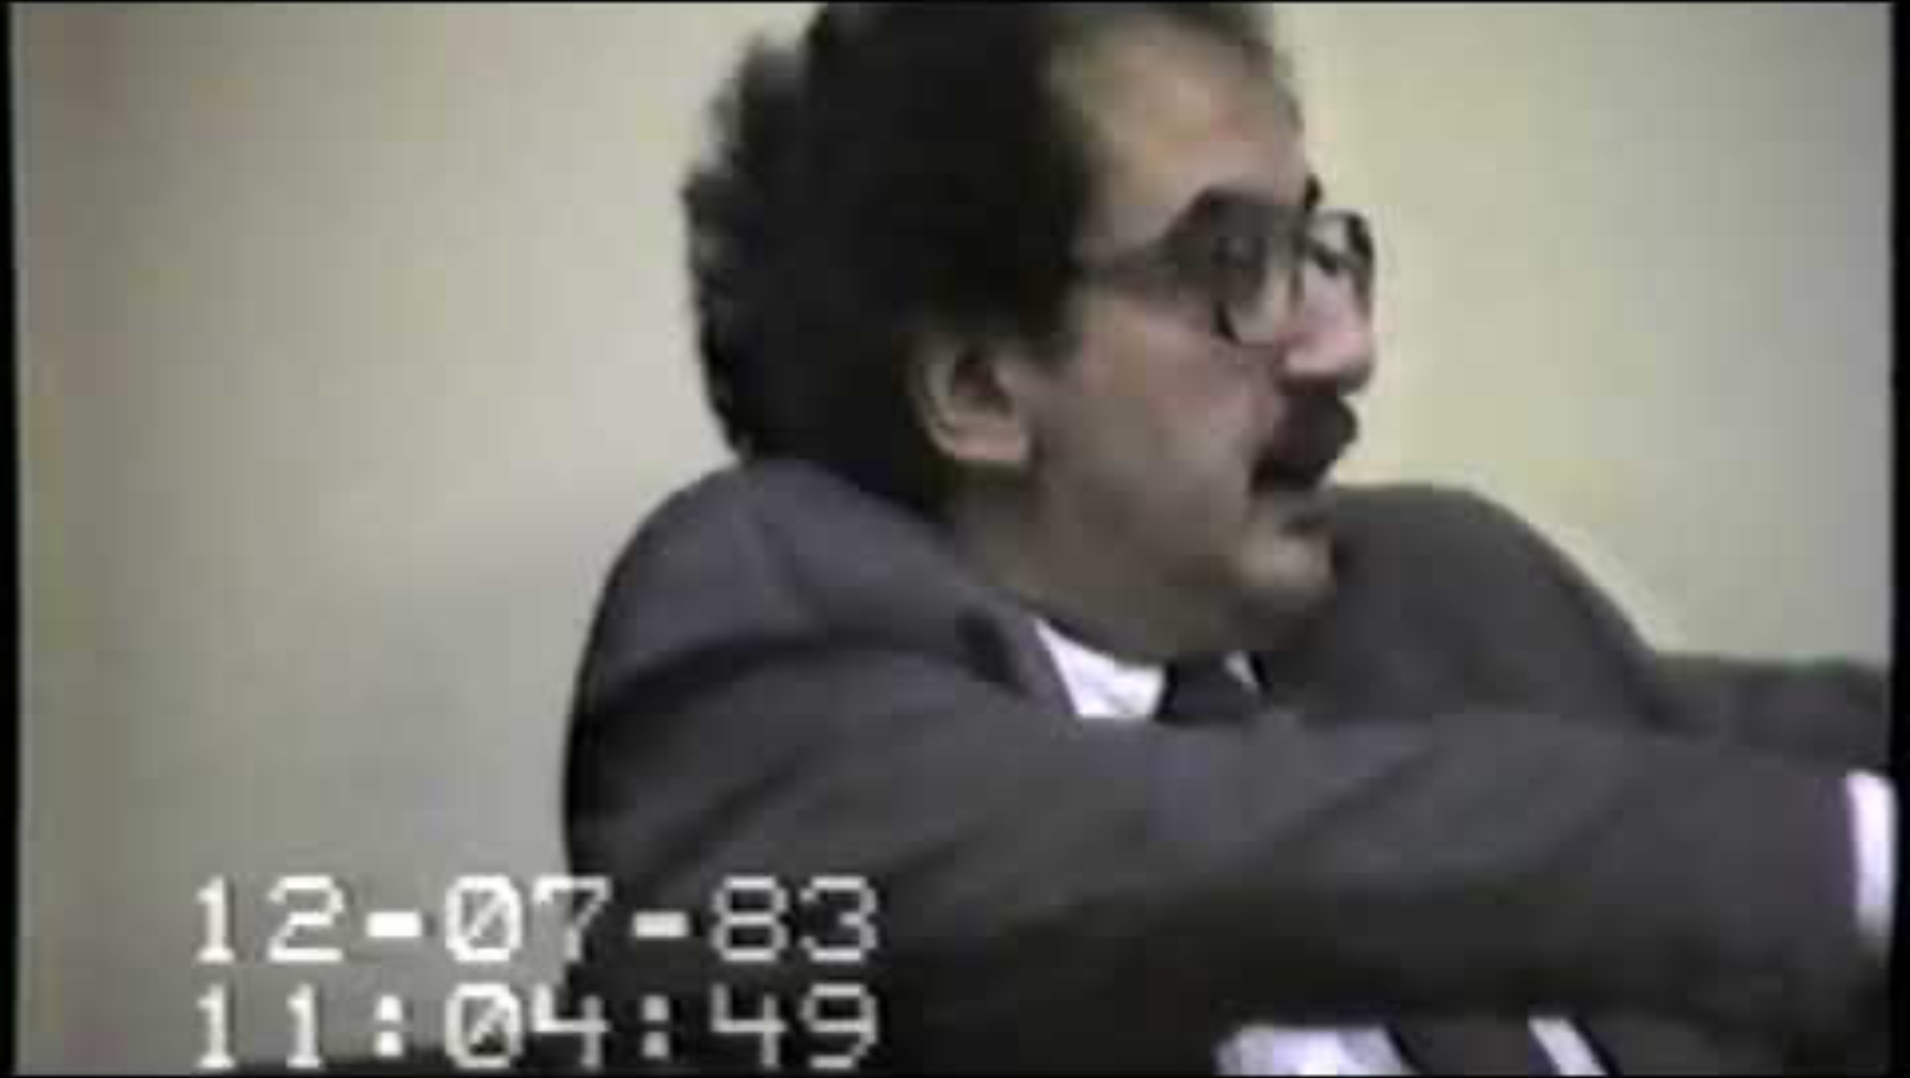
Ray Osheroff
In His Own Words
Osheroff Video

Slide 14
The Litigation
Osheroff v. Chestnut Lodge
The Claim
Negligence — failure to provide medication for a condition that warranted biological treatment
The Defense
Chestnut Lodge maintained its psychotherapeutic approach was clinically appropriate
The Stakes
Did patients have a right to evidence-based treatment? Could a hospital be sued for choosing the wrong paradigm?
The Outcome
Settled for an undisclosed sum — the case never reached final adjudication

Slide 15
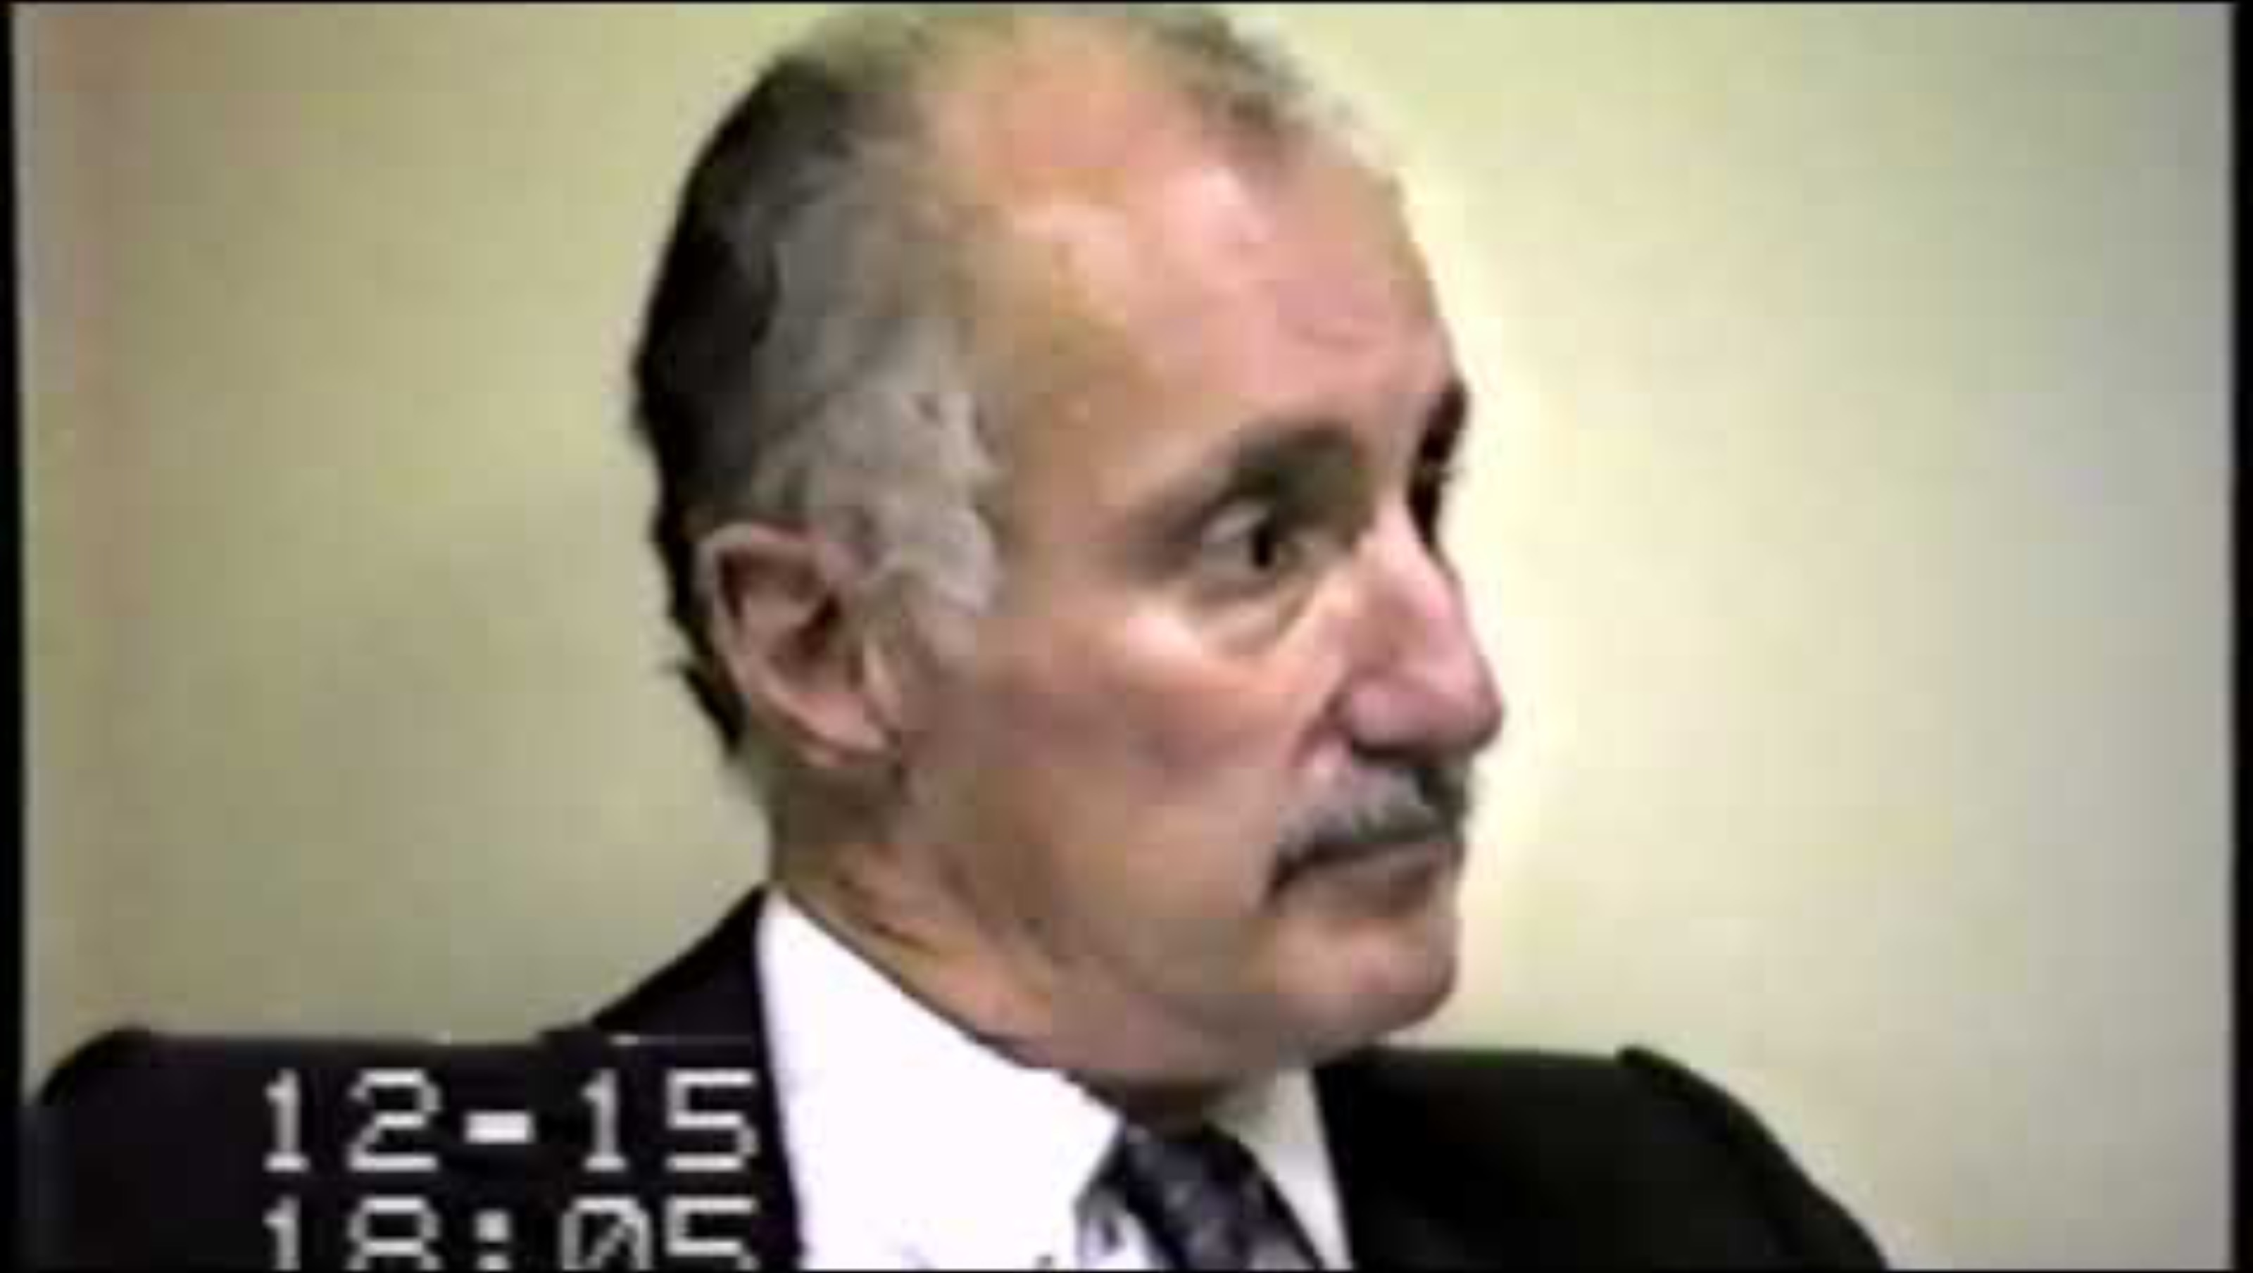
Ray Osheroff
If You Were Wrong Doctor
Hirschkop Video

Slide 16
Appropriated and Silenced
How different interests used the Osheroff case — and erased the man at its center.
Biological Psychiatry
Wielded Osheroff as proof that psychotherapy was dangerous and medication was the answer
Psychoanalytic Defenders
Dismissed his case as an anomaly — a difficult patient, a complicating personality disorder
Legal & Policy Circles
Used the case to argue for patients' rights to evidence-based care — but abstracted away the person

Slide 17
His Struggle to Be Heard
Ray Osheroff spent years trying to tell his own story — and was repeatedly denied the chance.
Attempted to publish his account of what happened — journals and publishers were uninterested
His manic episodes were used to discredit his testimony and his version of events
The psychiatric establishment preferred the case as an abstraction — not a person's lived experience
He became a symbol in a debate that had no room for the complexity of his actual life
He died in 2012, his story still largely untold on his own terms

Slide 18
A Pyrrhic Victory
The settlement brought financial compensation, but not vindication.
The case was settled, not adjudicated — no legal precedent was set
Biological psychiatry claimed victory, but the 'revolution' that followed brought its own harms
Psychoanalytic practitioners were chastened, but the nuances of psychotherapy's value were lost in the rout
Ray won his case but lost his career, his family, and ultimately his ability to shape his own narrative
The field learned the wrong lessons from the right grievance

Slide 19
What the Case Means Today
Questions for Clinicians and the Field
Beyond the false binary
The psychotherapy vs. medication debate was always a false choice — integration remains elusive but essential
Evidence and ideology
When does clinical conviction become unfalsifiable ideology? How do we recognize it in our own practice?
The patient's voice
Osheroff's experience was appropriated by every faction. Whose story matters most?
Institutional accountability
How do we prevent institutional cultures from overriding clinical evidence and patient welfare?

